Slide 1
Titanic Exploratory Data Analysis
DataX Labs Internship Project
Prepared By: Ritika Diwekar
Tools: Python, Pandas, Matplotlib, Seaborn

Slide 2
Project Overview
This project performs Exploratory Data Analysis (EDA) on the Titanic dataset to uncover trends, patterns and factors affecting passenger survival.

Slide 3
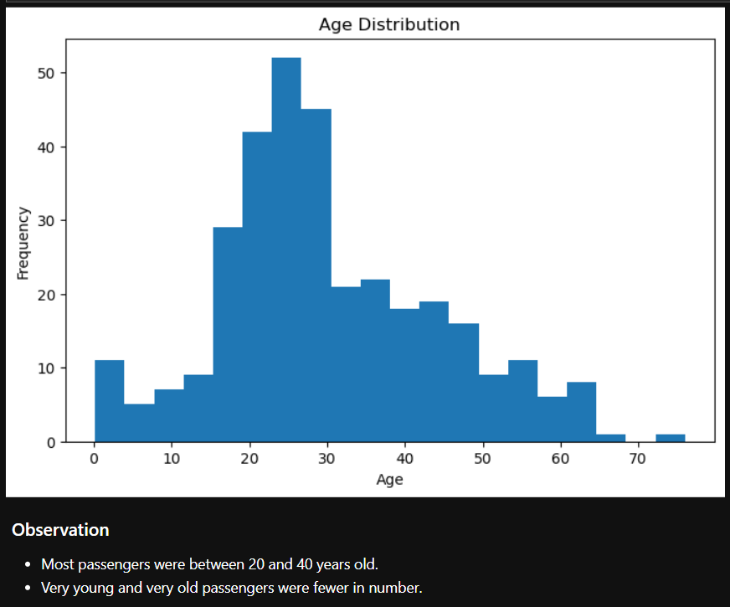
Age Distribution
.

Slide 4
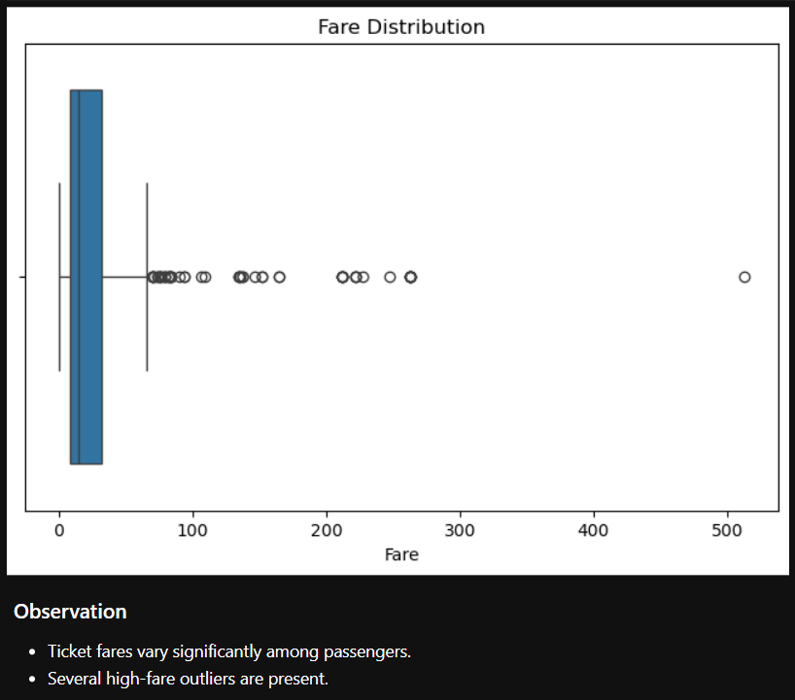
Fare Distribution

Slide 5
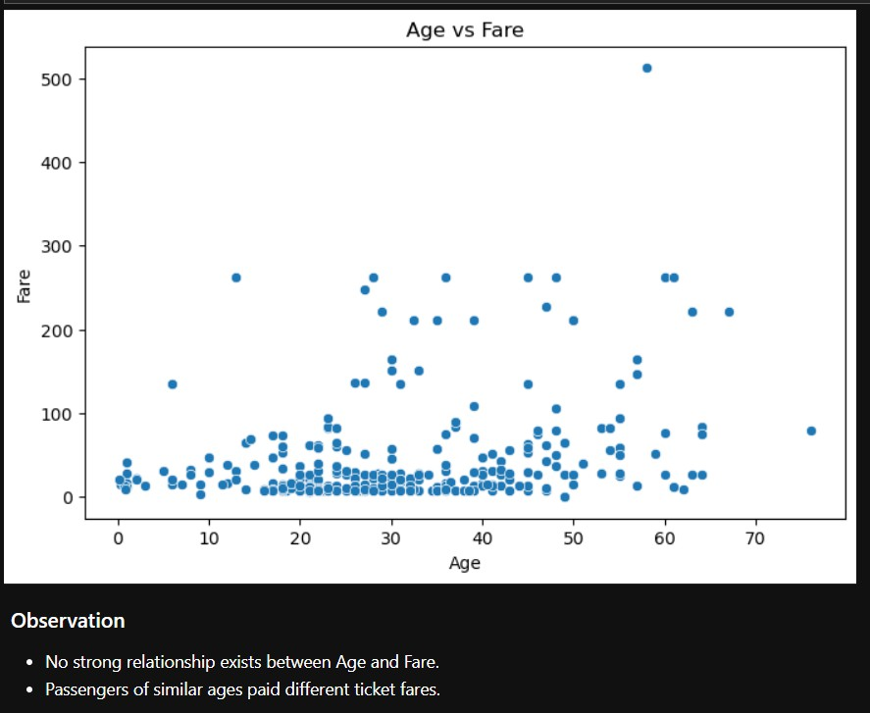
Age vs Fare

Slide 6
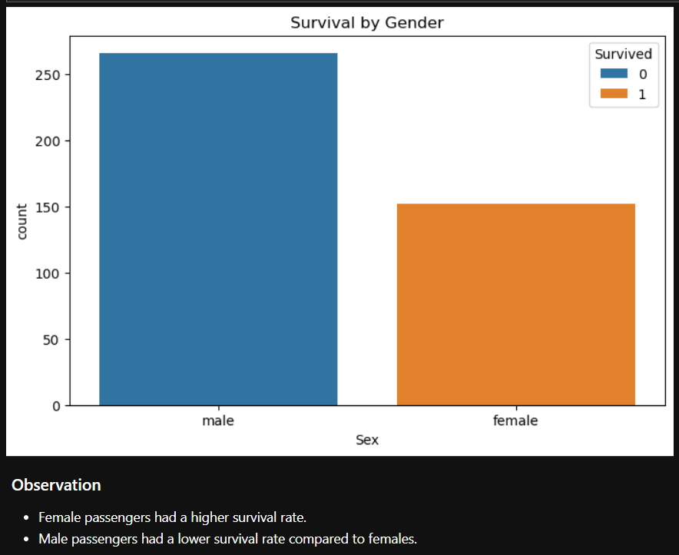
Survival by Gender

Slide 7
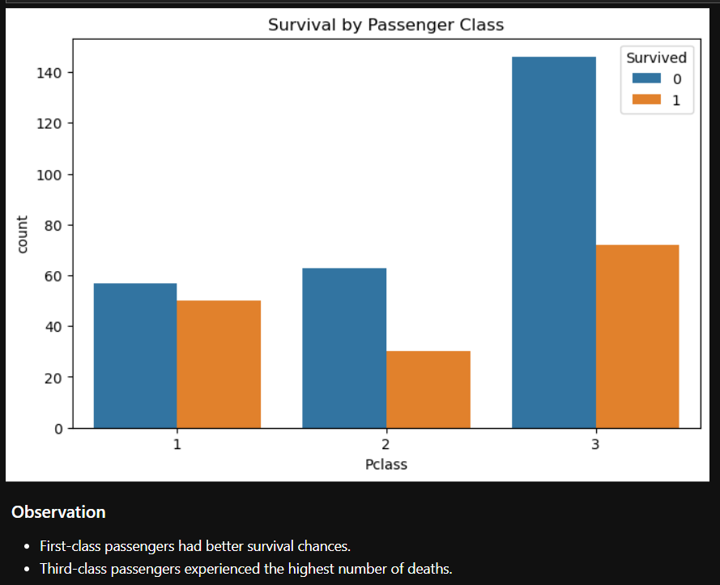
Survival by Passenger Class

Slide 8
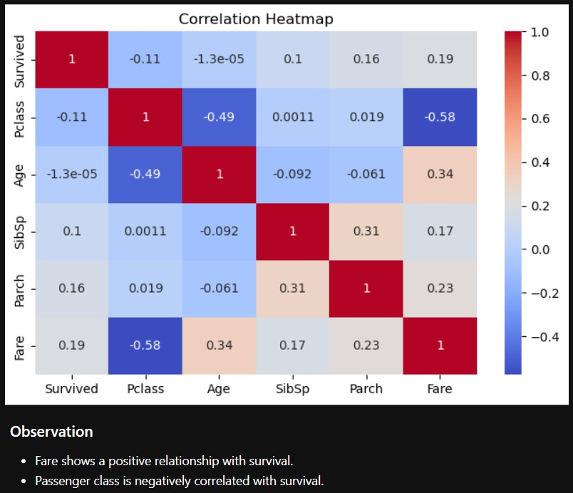
Correlation Heatmap

Slide 9
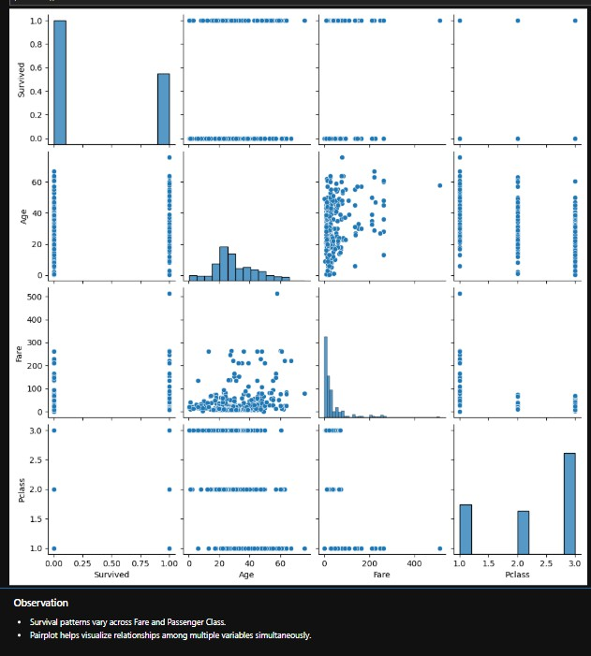
Pairplot Analysis

Slide 10
Key Findings
Most passengers were between 20–40 years old.
Female passengers had significantly higher survival rates.
First-class passengers had better chances of survival.
Ticket fares contained several outliers.
Fare showed a positive relationship with survival.
Passenger Class significantly influenced survival outcomes.

Slide 11
Conclusion
The Titanic EDA revealed that Gender, Passenger Class, and Fare were the most influential factors affecting passenger survival. Visualizations and statistical exploration helped uncover meaningful trends hidden within the dataset. This project demonstrates how EDA can transform raw data into actionable insights and support data-driven decision-making.

